Slide 1
Using MS Office 365 to Maximize Students use of Faculty’s Office Hours
Microsoft Higher Education Conference 2020
Carlos Coronel
Jones College of Business
Middle TN State University
ccoronel@mtsu.edu
This is NOT a technical presentation

Slide 2
Revisiting the way We do things …
Historically, colleges and universities have required office hours for faculty members:
- ensure faculty-student interaction
- promote team-work and camaraderie among staff
- just to ensure faculty comes to the office!
Let’s be honest, for years most faculty has been used to set their office hours based “mostly” on their schedules, committee meetings, and what is most convenient for them.
But is this BETTER for the students in pandemic times?

Slide 3
Research suggest …
Faculty-student interaction has been shown to:
- increase retention, student satisfaction & engagement,
- Provide a sense of belonging,
- Increase academic performance
These findings were true before the pandemic and are probably even truer now; in particular for new generation college students, international and minority students
This Photo by Unknown Author is licensed under CC BY-ND
(Bowen, 2012; Kim & Lundberg, 2016; Kuh, Kinzie, Schuh, & Witt, 2010; Dika 2012).

Slide 4
Why Virtual Office Hours?
- Convenience, anytime, anywhere (with boundaries)
- Good for student athletes, students with families and jobs (Bowen 2012)
- Work-life Balance (Tucker 2016)
- Compliment with group messaging tools (Teams, Slack, etc.)
The key: flexibility for both faculty & student – office hours when students and faculty are available

Slide 5
The TECHNICAL solution
Microsoft Office 365
Exchange 365
Bookings
Teams
This Photo by Unknown Author is licensed under CC BY-SA

Slide 6
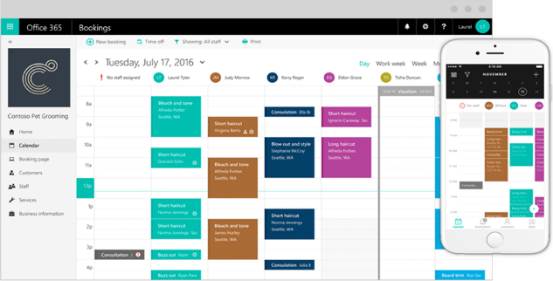
workflow
Student
Teacher
Outlook 365
Links in LMS, email & web
Booking page
Services
Staff
Calendar

Slide 7
Seizing the moment
Newsletters
Workshops
LMS Widget
Email signature
Website
1:1 Training faculty/staff
“Faculty development is a perennial challenge for institutions in building and improving remote and hybrid learning experiences, and it may be easier now than ever for IT and technology staff to start to build trust and engagement with their faculty.”
https://www.ecampusnews.com/2020/10/12/3-promising-higher-ed-tech-practices-emerging-from-covid
This Photo by Unknown Author is licensed under CC BY

Slide 8
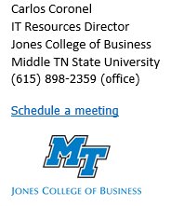
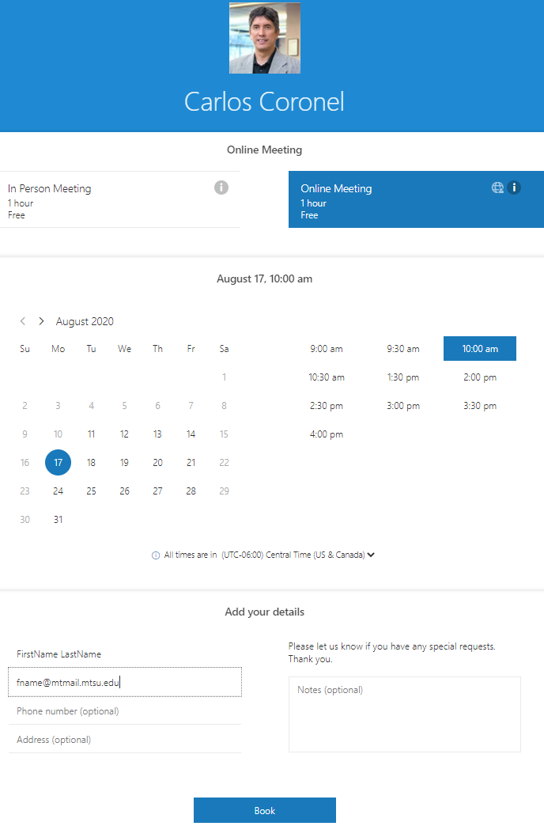
LIVE DEMO
Advantages
Already deployed to every user with O365
Ready out of the box
Zero lines of code
Integrated with standard email system

Slide 9
Challenges
Internet broadband access inequities
Customization:
- landing page(s) & look and feel
- messages text
Better integrations:
- LMS (Brightspace D2L)
- VMS (Panopto)
Zoom “ubiquitousness”
This Photo by Unknown Author is licensed under CC BY-NC-ND

Slide 10
Q & A

Slide 11
Sources
http://www.laspositascollege.edu/gv/assets/archives/03-5-14StudentSupportRedefined-SixSuccessFactorsPoster.pdf
https://rpgroup.org/Portals/0/CollegeFacultyStaffandAdmins/StudentSupportRedefined-10WaysEveryoneCanSupportStudentSuccess-January2014.pdf
https://www.mheducation.com/highered/insights-ideas/6-ways-to-move-to-virtual-office-hours.html#:~:text=Virtual%20office%20hours%20provide%20numerous,and%20best%20practices%20to%20consider.
https://www.facultyfocus.com/articles/effective-classroom-management/increase-office-hours/
https://www.insidehighered.com/advice/2020/06/17/professor-questions-value-set-office-hours-students-opinion
https://www.microsoft.com/en-us/microsoft-365/business/scheduling-and-booking-app

