Slide 1

Azure Secure workstation
Frank Simorjay
Sr. Program Manager Azure Security

Slide 2
Agenda
Why do you need a secure workstation
Recent attack examples
Overall design consideration
Building a trusted model
Deploying the solution

Slide 3
0-trust
Can you trust the device your using?
1
Can you trust the software your installing?
2
Can you trust your users?
3

Slide 4
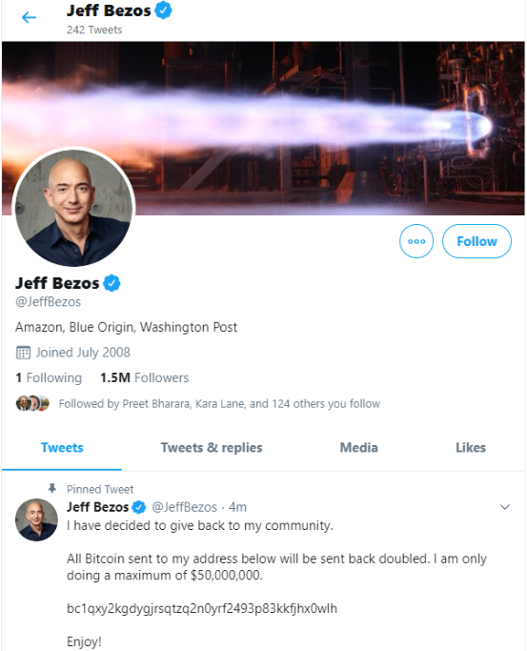
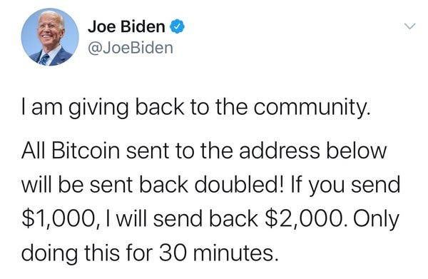
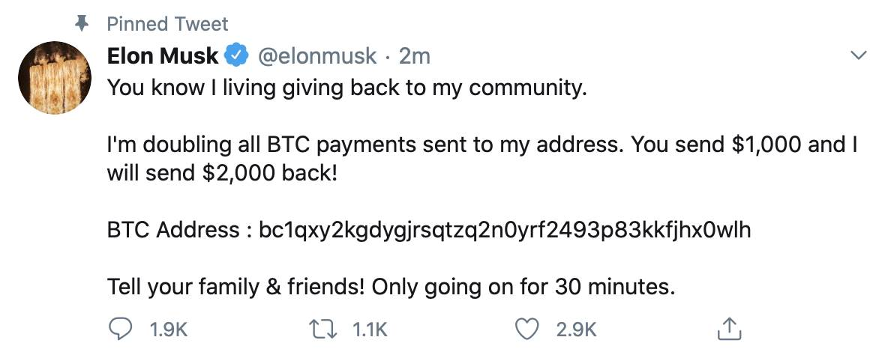
Twitter

Slide 5
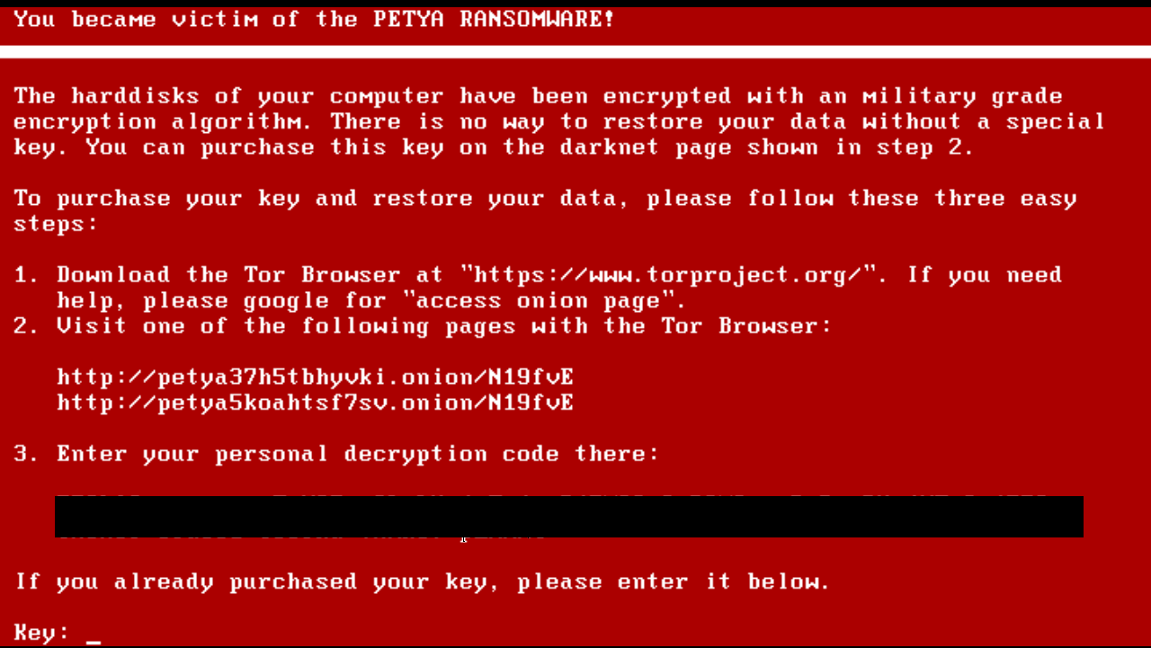
Petya

Slide 6
Building a trusted model
Users
Policies and software
Hardware

Slide 7
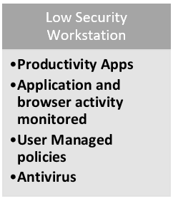
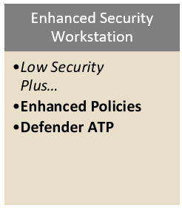
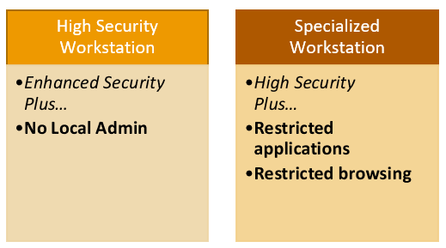
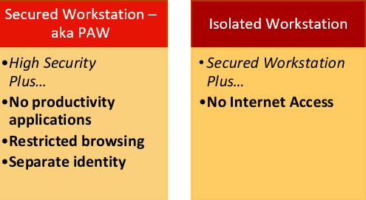
Role based workstation
ROLES
STANDARD USERS
HIGH IMPACT USERS / DEVELOPERS
IT OPERATIONS
PROFILES
SECURITY CONTROLS
https://docs.microsoft.com/en-us/azure/active-directory/devices/concept-azure-managed-workstation

Slide 8
Implementing the profile
ROLES
STANDARD USERS
HIGH IMPACT USERS / DEVELOPERS
IT OPERATIONS
Profile | Low | Enhanced | High | Specialized | Secured | Isolated
User in Azure AD | Yes | Yes | Yes | Yes | Yes | Yes
Intune-managed | Yes | Yes | Yes | Yes | Yes | Yes
Device - Azure AD registered | Yes
Device - Azure AD joined |  | Yes | Yes | Yes | Yes | Yes
Intune security baseline applied |  | Yes (Enhanced) | Yes (HighSecurity) | Yes (NCSC) | Yes (Secured) | NA
Hardware meets secure Windows 10 Standards |  | Yes | Yes | Yes | Yes | Yes
Microsoft Defender ATP enabled |  | Yes | Yes | Yes | Yes | Yes
Removal of admin rights |  |  | Yes | Yes | Yes | Yes
Deployment using Microsoft Autopilot |  |  | Yes | Yes | Yes | Yes
Apps installed only by Intune |  |  |  | Yes | Yes | Yes
URLs restricted to approved list |  |  |  | Yes | Yes | Yes
Internet blocked (inbound/outbound) |  |  |  |  |  | Yes

Slide 9
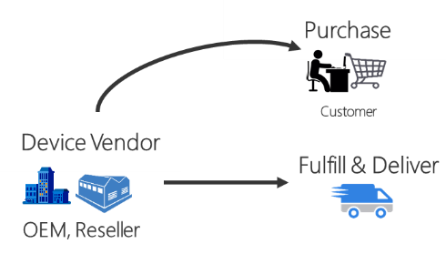




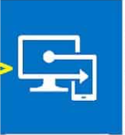


Enhanced Workstation
Delivery
Device Registration
Windows 10 RS5+ Client
Device Attestation
User, and Group Assignment
Policies
Registration
Windows
Autopilot
Azure ATP
System Guard Attestation Service
Intune
Intune
Azure AD
Authentication/Image
Request
User Authentication
User Flow
System Flow
Notes:
Speaker: Rob
Walkthrough
OEMs manufacture a device that is registered with Windows Autopilot as going to a specific customer (e.g.; Microsoft). Devices are registered using a device hash generated by Autopilot.
After being registered, devices will be shipped in Windows 10 in S-Mode OOB. This provides a secure OOBE and can go in and out of S-Mode at will via Autopilot.
Upon receiving a device, users can connect the device to the Internet and authenticate with AAD. Windows Autopilot will verify the device using ATP / Attestation, then start to pull down Intune policies if the device is what it claims to be and has not been tampered with.
Intune provies policies, Autopilot fetches the policies from Intune
Talk about security safeguards this provides
Dev Experience
Because of AP + S-Mode, we can be up and running in ~30 minutes

Slide 10
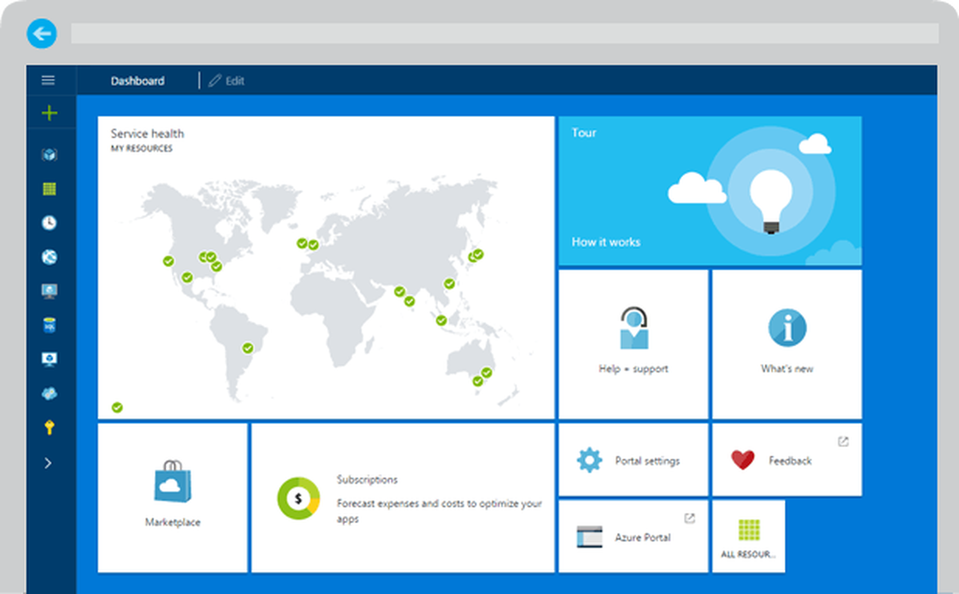
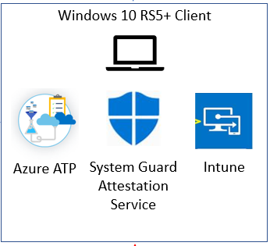

Secured Workstation
Isolated Intune management Tenant
Customer Tenant
Device Registration
Azure AD
Azure AD
Device
Conditional
Access
Intune
RBAC
Device Ordered - delivered
❼
User
Notes:
Speaker: Rob
Walkthrough
OEMs manufacture a device that is registered with Windows Autopilot as going to a specific customer (e.g.; Microsoft). Devices are registered using a device hash generated by Autopilot.
After being registered, devices will be shipped in Windows 10 in S-Mode OOB. This provides a secure OOBE and can go in and out of S-Mode at will via Autopilot.
Upon receiving a device, users can connect the device to the Internet and authenticate with AAD. Windows Autopilot will verify the device using ATP / Attestation, then start to pull down Intune policies if the device is what it claims to be and has not been tampered with.
Intune provies policies, Autopilot fetches the policies from Intune
Talk about security safeguards this provides
Dev Experience
Because of AP + S-Mode, we can be up and running in ~30 minutes

Slide 11
Deploying the service
WORKSTATION PROFILE SCRIPTS
Profile | Download location | Filename
Low Security | N/A | N/A
Enhanced Security | https://aka.ms/securedworkstationgit | Enhanced-Workstation-Windows10-(1809).ps1
High Security | https://aka.ms/securedworkstationgit | HighSecurityWorkstation-Windows10-(1809).ps1
Specialized | https://github.com/pelarsen/IntunePowerShellAutomation | DeviceConfiguration_NCSC - Windows10 (1803) SecurityBaseline.ps1
Secured | https://aka.ms/securedworkstationgit | Secure-Workstation-Windows10-(1809)-SecurityBaseline.ps1
Isolated | N/A | N/A
Ensure your licensing is aligned with your role
Configure your users and AD user groups
- Enable MFA
Configure your MDM Intune instance
Set up conditional Access
Setup Autopilot enrollment
Configure your windows update
Enable Defender ATP, and MCAS
Deploy your roles profile
https://docs.microsoft.com/en-us/azure/active-directory/devices/howto-azure-managed-workstation

Slide 12





Supply chain management using autopilot
Benefits of Modern hardware
Register with OEM
OEM prepares device
Trusted Platform Module (TPM) 2.0
BitLocker Drive Encryption
UEFI Secure Boot
Drivers and Firmware Distributed through Windows Update
DMA I/O Protection
System Guard
Modern Standby
Place device order
Device is shipped
Secure delivery

Slide 13

Autopilot demo

Slide 14
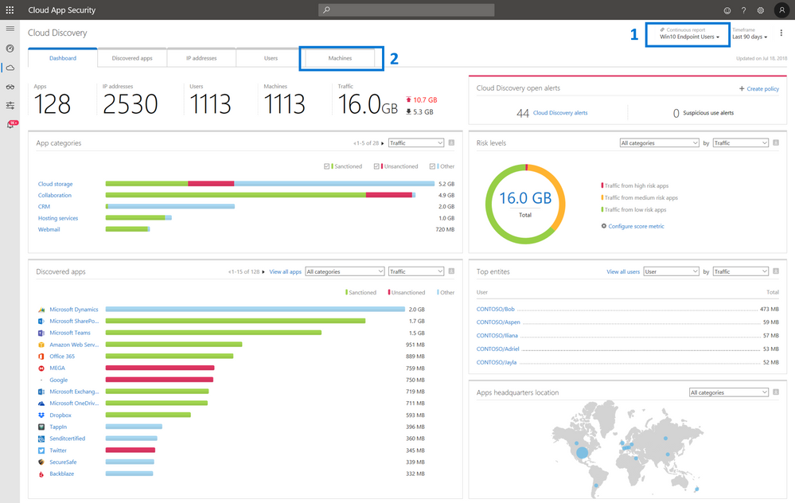
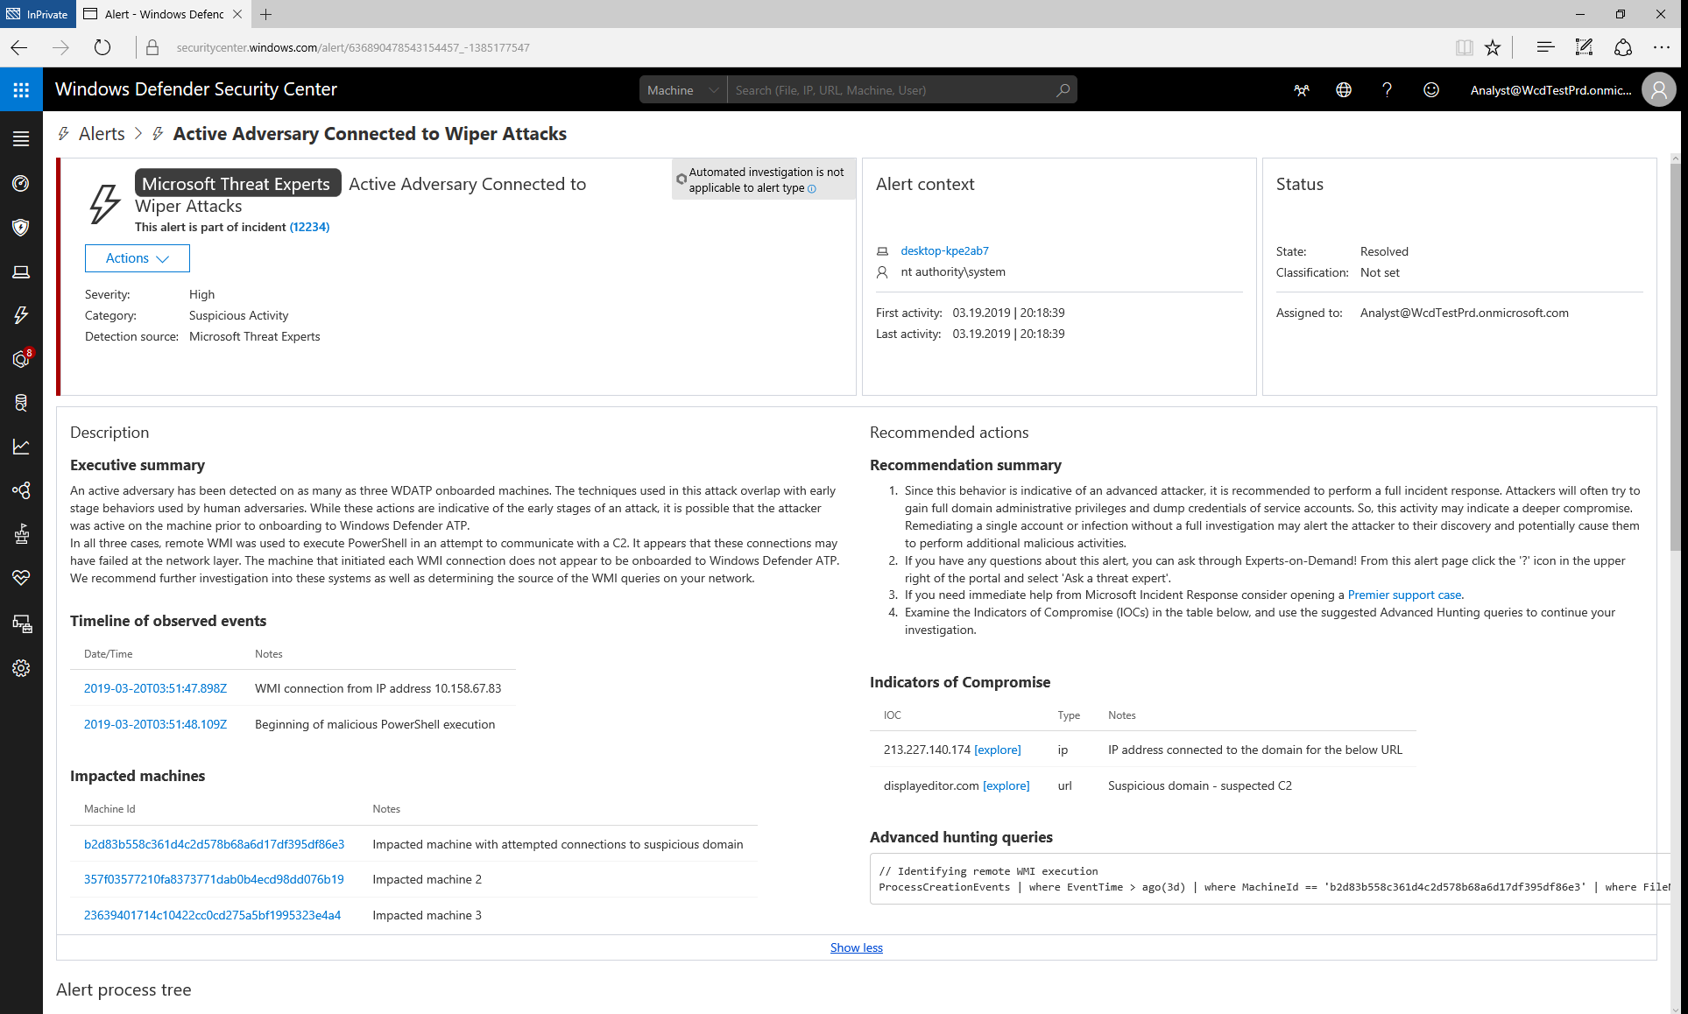
Microsoft Cloud App Security and Windows Defender ATP

Slide 15
Revisit Twitter, Petya
ROLES
STANDARD USERS
HIGH IMPACT USERS / DEVELOPERS
IT OPERATIONS
Enhanced Security Workstation
Would not have been prevent
Secured Workstation –aka PAW
JIT access require second factor auth activity blocked
Specialized Workstation
Application access review – activity detected
High Security Workstation
Would not have been prevent
Would not have been prevent
Isolated Workstation
Not connected
Low Security Workstation
PROFILES
Twitter Attack
Enhanced Security Workstation
ATP blocks spread and raises alert
Secured Workstation –aka PAW
Never receive phish
Specialized Workstation
Redirect fails
High Security Workstation
Elevation execution fails
Monitoring detect suspicious activity
Isolated Workstation
Not connected
Low Security Workstation
Attack blocked
Code not signed application fails
PROFILES
NotPetya

Slide 16
Thank you

